Slide 1
Work
14 - 1

Slide 2
Lesson Objectives
I can describe the factors that affect work.
I can explain how to increase or decrease work.
I can describe the conditions that must exist for a force to do work on an object.

Slide 3

What is “Work”?
When an object actually moves in the same direction as a force.
Is the product of force and distance in the direction object moves.
The movement of Homer in the same
direction as the force that pushed
him means that some work
was accomplished!
Force

Slide 4

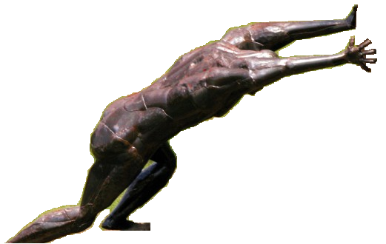
Work
A push or pull can always be applied, but its not until we actually move it that the person did work on the object.
Whe-hew
This is FUN!
Ungh!
This is HARD WORK!
Work is when a force moves an object
If we apply a force of 100 N, but
the object doesn’t move, how
much work was done?
100 N x O m = ? W
Think: If no movement occurs,
was any work actually done?
Force
(Push)
Distance
Here’s the point: Work is what was actually accomplished!

Slide 5
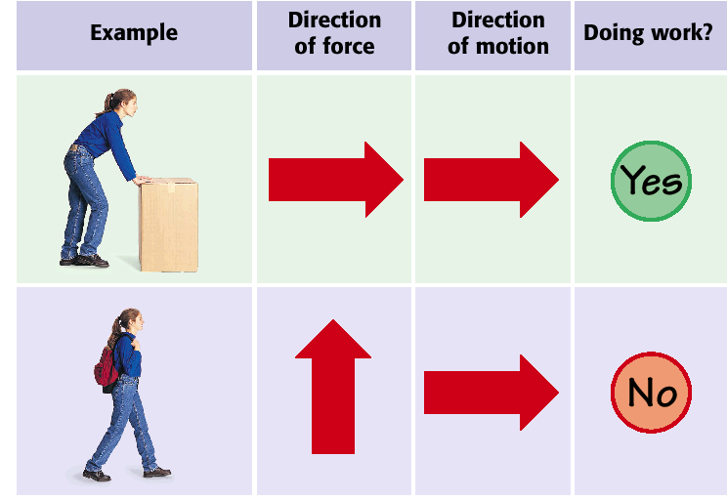
Work or Not Work

Slide 6
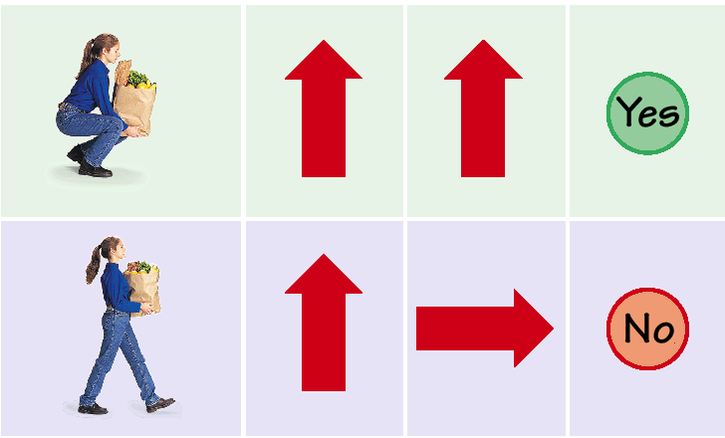
Work or Not Work

Slide 7
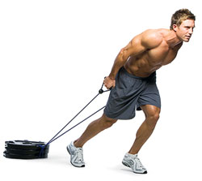
Is work being done when he pulls the weight?

Slide 8

Is work being done or not?
Mowing the lawn
Weight-lifting
Moving furniture up a flight of stairs
Pushing against a locked door
Swinging a golf club
YES
YES
YES
NO
YES

Slide 9
Work is done on an object of the following 2 things occur
Object moves as force is applied.
Direction of the objects motion is same as direction of force applied.

Slide 10
Name the 2 factors that affect the amount of work done
Force
Distance

Slide 11
Do you do more work when you finish a job quickly?
Work does NOT involve time, only force and distance.
No work is done when you stand in place holding an object.

Slide 12
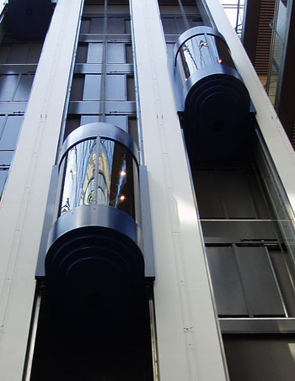
Main Concept
Work is only done when the force and motion are in the same direction .
  The elevator is creating a force that moves the container up. The force and movement is the work that the elevator has accomplished.

Slide 13
Formula for Work
Work is measured in a unit called “Joules”

Slide 14
Calculating Work
work = force x distance
W = F x d
All or part of the force must act in the direction of the movement.
Joules
Newtons
Meters

Slide 15
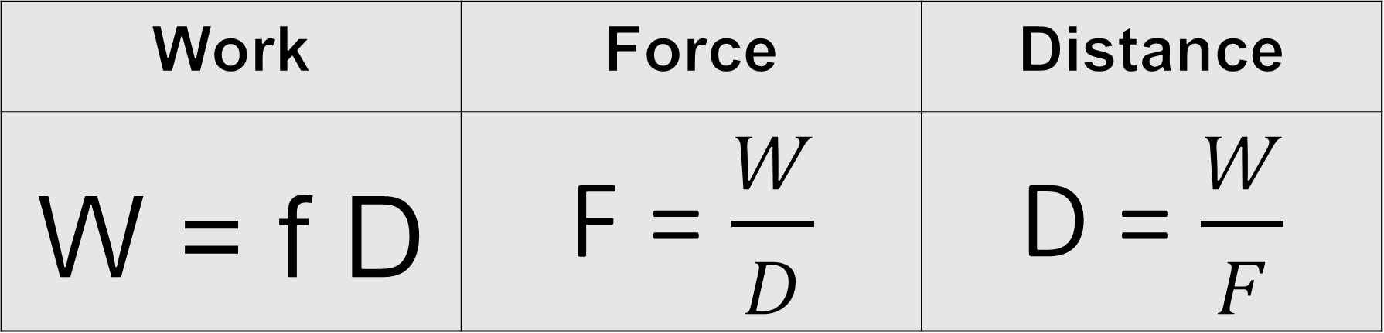
Work Related Equations
Work | Force | Distance
W = f D | F = $\frac{W}{D}$ | D = $\frac{W}{F}$

Slide 16
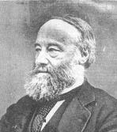
The Joule
1 newton-meter is a quantity known as a joule (J).
Named after British physicist James Prescott Joule.

Slide 17
Big Ideas
1) Work is only done when you exert a force that moves an object in the direction of the force.
2) The 2 factors that affect the amount of work are FORCE and DISTANCE.

